Slide 1

Belfast Region Music Board

Slide 2
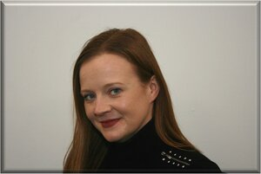
Abbie Triggs - Director of Operations and Business Development On Music Ltd
Abbie Triggs is the Director of Operations and Business Development at On Music Ltd - the leading provider of back-office administration services for organisations in the media industry. Over the past 18 years, Abbie has worked with some of the world's largest performance rights organisations, television broadcasters and music publishers to establish best in class standards for metadata relating to copyright and royalty administration. She is passionate about educating creatives on leveraging the power of data to ensure copyright owners are fairly remunerated for the use of their Intellectual Property.

Slide 3
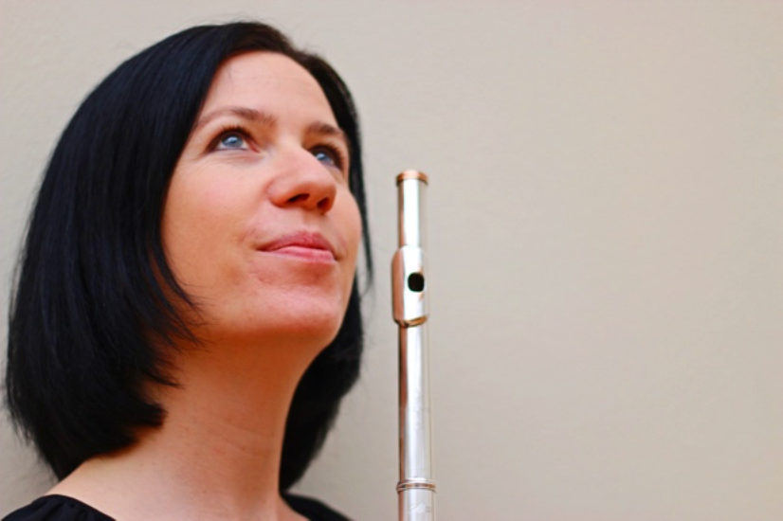
Aisling Agnew - Professional Flautist / Concert Manager
(1/2)
Aisling Agnew is a flautist from Belfast. She performs internationally and has performed at prominent festivals such as the National Flute Association’s 40th Convention at Caesar’s Palace Las Vegas, Jeonju International Sori Festival in Korea, Sarajevo Winter Festival and closer to home at New Music Dublin, British Flute Convention in Manchester, Celtic Connections in Glasgow, and Belfast International Festival as both a soloist and chamber musician.
Aisling is host of the successful podcast The Flute NI and has interviewed many performers, teachers and makers about their experiences. Aisling has made many successful recordings featuring CDs, radio broadcasts and live performances and she specialises in playing a wide range of flutes, performing on silver and wooden concert flutes as well as baroque and Irish flute and whistle. Aisling is a graduate of the Guildhall School of Music & Drama and the Royal Conservatoire of Scotland and is the recipient of many awards including the Countess of Munster, Arts Council of NI, Creative Scotland and Belfast Classical Music Bursaries. Her latest solo album recording ‘Alone’ is due for release in 2023.

Slide 4
Aisling Agnew - Professional Flautist / Concert Manager
(2/2)
Reflecting her passion for contemporary music, Aisling is both flautist and concert manager with Hard Rain Soloist Ensemble in Belfast. They specialise in bringing new music to audiences in NI and helping promote composers from Ireland. They regularly work with young musicians from Queens University (where they are Ensemble in Residence) and the Ulster Youth Orchestra.
Aisling also performs with the Irish Memory Orchestra, collaborating with Irish traditional musicians and she regularly freelances with various orchestras in the UK and Ireland such as Ulster Orchestra. Aisling performs in several chamber groups such as the Clyde Duo with Welsh harpist Sharron Griffiths with whom she has toured extensively. Aisling is involved with a variety of music education programmes such as the Ulster Orchestra's Crescendo Project, she teaches at Queen’s University Belfast and has given many international masterclasses and workshops including for BBC Ten Pieces NI and Classic Children’s Concerts in Scotland. Aisling has worked with Drake Music, collaborating with musicians with additional needs and she has also conducted various ensembles including Flute Phonics and St Andrews Flute Ensemble.

Slide 5
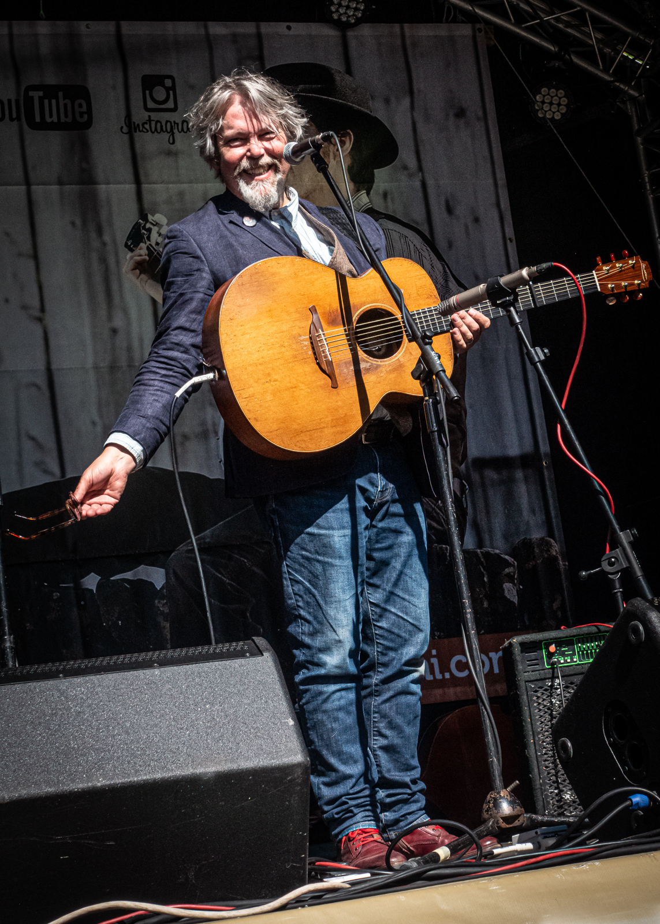
Anthony Toner - Freelance Singer-Songwriter
I am a self-employed singer songwriter and musician, with extensive additional experience in print journalism (17 years) and arts management (11 years). Alongside those careers I have always worked as a semi-professional musician for almost 35 years, in all kinds of genres and situations, from country & western dance bands to session work and writing music for theatre. I have released thirteen albums of original material, picked up strong reviews and radio play - and I’ve performed throughout the UK and also in the United States and Canada. Along the way I have shared my experience in occasional mentoring sessions for emerging artists, songwriting workshops and more recently with informal help and suggestions for festival content, in terms of suggesting suitable artists, venues, or creating bespoke events.

Slide 6
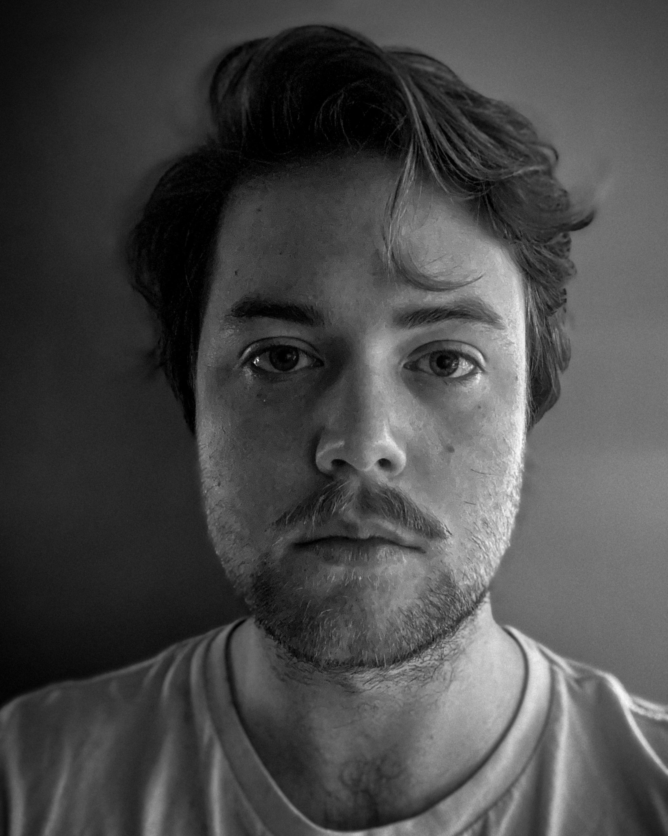
Ben Magee - Director of New Champion Management
A music enthusiast at heart, Ben’s journey in the music industry began on the cowboy side, as a journalist and roadie for acts in his local scene. This all changed when he established New Champion Management in late 2019, setting up a home and infrastructure for the artists and sounds that he loved.
With global partners, 80+ million streams across the roster and live performances in 20+ countries, New Champion represents the best artists in Ireland with bespoke strategy and unwavering passion. Ben has served as a creative consultant for UNESCO, Belfast City Council, and has been a guest speaker at numerous conferences and artist development programmes across Ireland and the UK.
Currently, he heads up the creative, logistic and business strategy for New Champion Management from its HQ in Belfast, NI

Slide 7
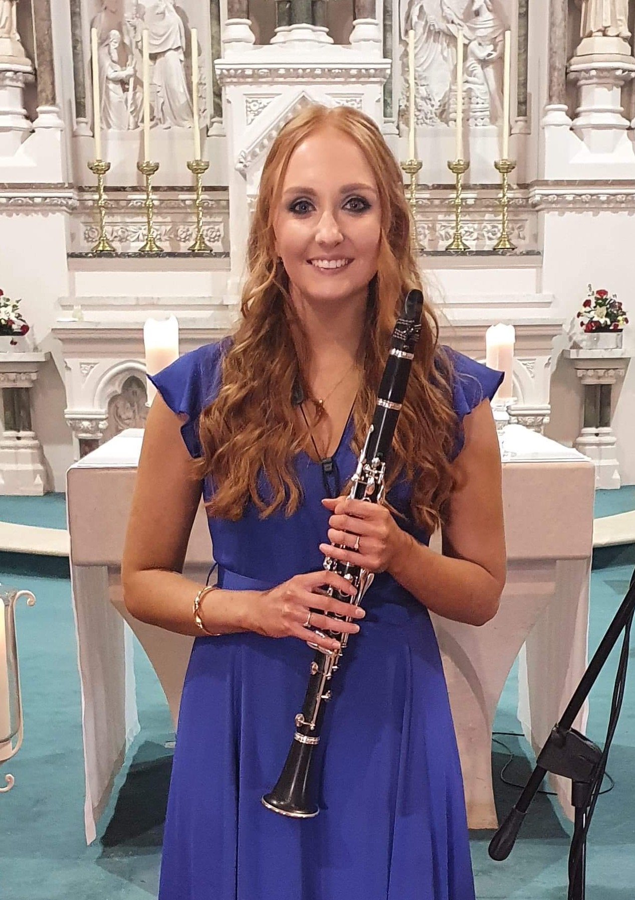
Bethany Simpson - Concerts Manager Belfast Music Society
Bethany graduated from Queen’s University Belfast with a First-Class Honours Bachelor of Music degree. Whilst at university, she won many prestigious awards including the Hamilton Harty Scholarship on two occasions and the Flax Trust Bursary for gaining the highest mark in music performance. She now enjoys a varied career as a professional clarinettist whilst also dividing her time as the Concerts Manager for both the Belfast Music Society and Newry Chamber Music. Aside from this she is currently undergoing a Masters in Innovation, Leadership and Management with the University of York.

Slide 8
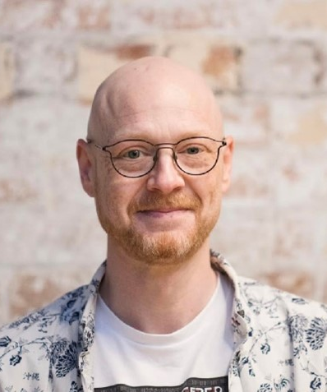
Boyd Sleator - Co-Founder of Free the Night, Coordinator of NI Humanists
Boyd Sleator, co-founder of Free The Night and Coordinator of Northern Ireland Humanists, is deeply invested in Belfast's music scene. Skilled in strategic planning and community building, he advocates for vital reforms like entertainment and alcohol licensing and the development of the nighttime economy.
Boyd works on the challenges around infrastructure, safety, and space for creative activities. His understanding of Belfast's nighttime economy allows him to effectively engage with key stakeholders in the community as well as those in government and local authority areas. On the Belfast Region Music Board, Boyd is committed to championing local talent and underserved communities, intending to showcase Belfast as a global hub of creativity.

Slide 9
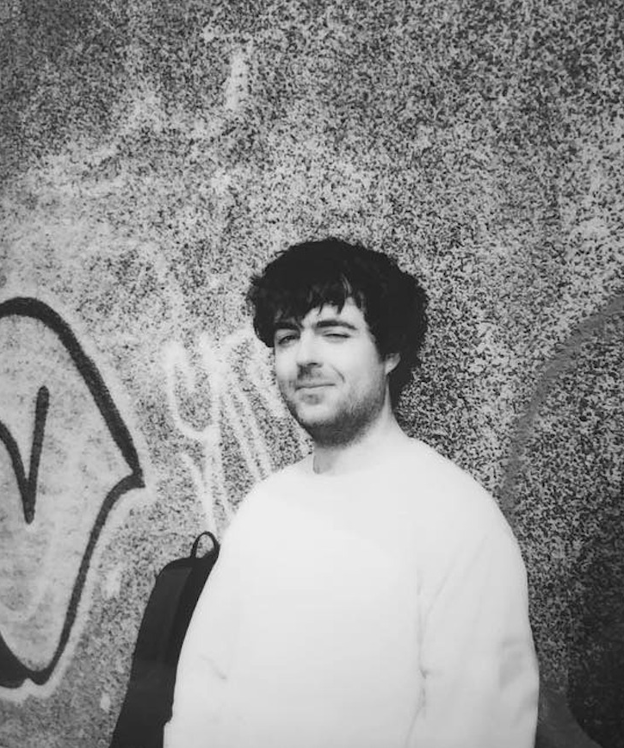
Brian Coney - Editor / Writer / Musicians / PR Representation / The Thin Air
Brian Coney is the editor of Irish music and culture magazine The Thin Air and a writer for publications including Pitchfork, Rolling Stone, The Guardian, the Quietus, Bandcamp, VICE and elsewhere. He's also a DJ, promoter, co-founder of the Belfast band Junk Drawer, a freelance PR representative, and the social media manager for Belfast City Council's Belfast Music channels.

Slide 10
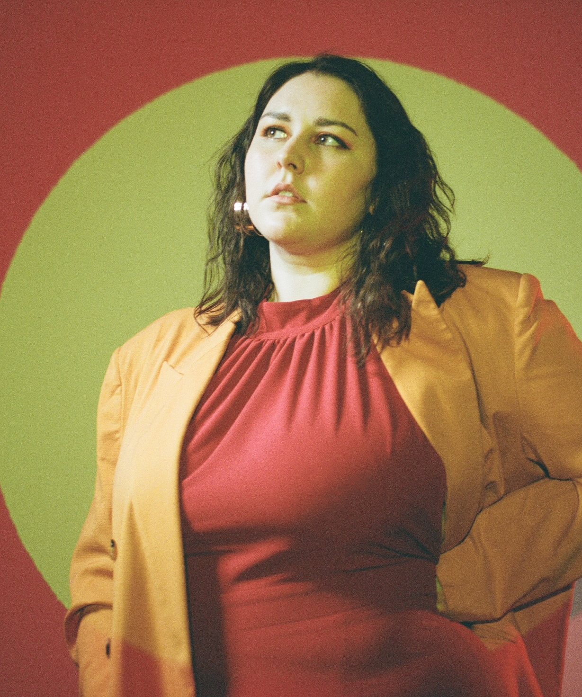
Cheylene Murphy - Freelance Musician
Cheylene Murphy is a songwriter, producer and musician primarily known for her NI Music Prize nominated art-pop duo Beauty Sleep. Having contributed to songs, recordings and performances with many Belfast bands including Wonder Villains, Hex Hue, CATALAN! and Pleasure Beach, Cheylene has had international success with the music she has created, touring the globe appearing at festivals such as SXSW, The Great Escape and Electric Picnic, gaining over a million streams and receiving daytime radio play on the likes of BBC Radio One and 6Music.

Slide 11
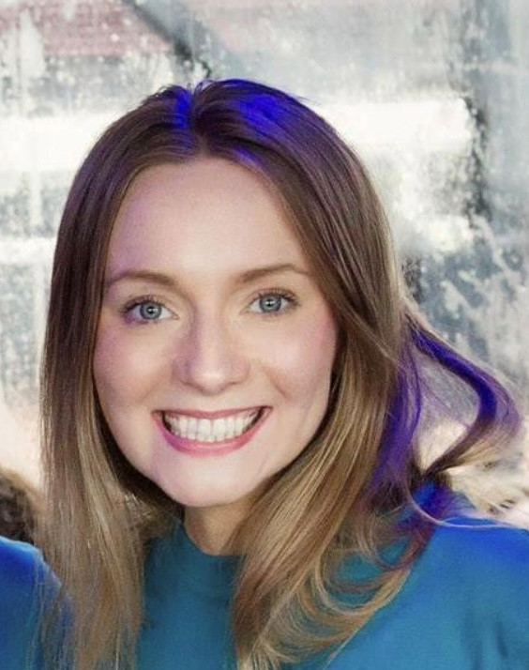
Claire Kieran - Oifigeach Imeachtaí at An Droichead
Claire is the Arts Events Officer in An Droichead, the leading Irish language and cultural centre in South Belfast. Here she manages the year-round events programme and the annual festivals which present some of the finest musicians and artists working in traditional music today both in Ireland and internationally.
During her time at An Droichead, Claire established the first Belfast Traditional Music Trail which has become a major tourism product in Belfast and has become one of Tourism NI’s Embrace a Giant Spirit brand signifiers for the global launch in 2019. In addition, she has expanded the scope of the arts activities undertaken by An Droichead to encompass other elements of the tradition, including visual arts and composition.
Prior to her work at An Droichead, Claire spent several years working as an Irish Language teacher and as a primary teacher within the irish medium education sector. Claire was on the judging panel for BBC Radio 2 Folk awards and was a member of the steering group or the Belfast UNESCO city of music bid.

Slide 12
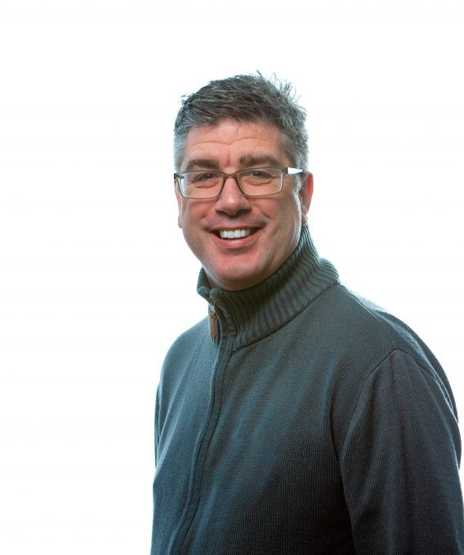
Glenn Millar - Musician, podcast host and author of Made to Parade
(1/2)
I have had close to a lifelong dedication to the arts, I believe I have left my mark on the world of local traditional music and voluntary theatre through multifaceted talents and commitment to promoting the positive understanding of community arts.
With a career spanning over four decades, I began my arts artistic journey as a member of a flute band, embarking on an 41-year tenure. This dedication led me to become a Flute Band League All Ireland Champion, and a multiple Northern Ireland Bands Association Melody Grade Champion.
Beyond these instrumental accomplishments, I have demonstrated an ability to bring artistic visions to life, through serving as the Technical Director for the Heel and Ankle Community Theatre Company, infusing expertise and creative vision into every production.
Not content with simply conducting, I extended my artistic reach as a composer, arranger, and educator for the Ballymacarrett Defenders and Pride of the Raven Flute bands. I have crafted original pieces, tailored for parade and indoor competitions. These compositions, born from a deep understanding of the craft, breathed new life into these band's repertoires.
I was part of the team that co-wrote the captivating original play, "Flutes, Flags & Flames," in collaboration with Heel and Ankle. This dynamic production not only provided me with the opportunity to act, but also to craft sound effects, incidental music, and visuals. Theses contributions added a new layer of depth and emotion to the performance.

Slide 13
Glenn Millar - Musician, podcast host and author of Made to Parade
(2/2)
I have also dedicated my talents to the cause of peace and reconciliation. Through involvement with Beyond Skin, I have facilitated workshops that harnessed the power of the arts to engage young people in meaningful dialogue.
By using music and other artistic forms, helped create an environment where diverse voices could be heard, fostering understanding and harmony among participants. I am committed to using art as a catalyst for positive change and played a role as a founding member of the #artsdialogue group, empowering young people to utilise their artistic abilities to create a platform for dialogue, using art as a medium for bridging divides and fostering mutual respect.
I have also been involved with numerous Beyond Skin projects, including Marching Metal, World Music Day, and World Youth Day.
These collaborations on these have demonstrated my ability to transcend cultural boundaries, spreading messages of unity and understanding through their artistic expression.
Through the mediums of podcasting, live streaming and television productions for my own artistic venture ‘Made to Parade’ I have been harnessing the power of positive narratives to foster understanding of cultural art expressions and build relationships with a desire to maintain a solid sense of community.
.

Slide 14
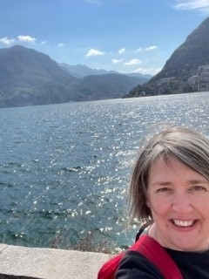
Jenny Kirkwood - Music Therapist, British Association for Music Therapy (BAMT)
I am a music therapist, and worked for a Belfast-based music therapy charity for 12 years in a range of health, education and community settings. As a music therapist, I used music through improvisation, composition, and listening to support people of all ages and backgrounds to work towards their individual therapeutic or wellbeing goals. I have a degree in music (1999) and a Master’s in Music Therapy (2015).
I am a member of the Board of Trustees of the British Association for Music Therapy, which is the UK professional body for music therapy, and it is related to this role that I am part of the Belfast Region Music Board.
Since 2019 I have worked for the Public Health Agency in a wider healthcare role involving Northern Ireland-wide service improvement projects, currently in children’s emotional health and wellbeing. This has given me comprehensive knowledge of public health, population health, and the social determinants of health, among other areas.
Outside of work I spend a lot of my time managing the social lives of my two teenage sons, but I also enjoy all things Italian, reading, drawing, crocheting, singing in choirs, playing piano, clarinet and guitar at a (very) amateur level and walking by the sea while litter picking.

Slide 15
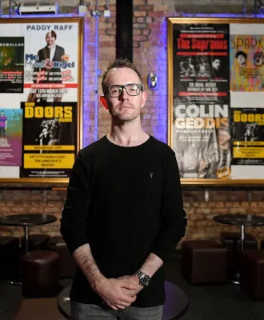
Joe Dougan - Director, TSW Management / The Limelight / Shine / Belsonic
(1/2)
Joe Dougan is a Concert Promoter based in Belfast. He began a career in the music industry in 1999 as a musician, performing locally and internationally with a variety of N.I. based acts. For the last 20 years he’s been organising & promoting concerts in the city, encompassing international and NI acts. He is a Director at Shine, the concert promotions company behind The Limelight venues in Belfast, The Academy venues in Dublin, The Telegraph Building in Belfast, and a year round programme of concerts at venues including Belfast’s Waterfront Hall, SSE Arena, Ulster Hall, Empire Music Hall, Derry’s Millennium Forum & many others. Shine’s interests also include the Belsonic, Custom House Square and EMERGE outdoor events in Belfast (attracting in excess of 200,000 attendees P/A), as well as internationally established electronic music brand Shine.

Slide 16
Joe Dougan - Director, TSW Management / The Limelight / Shine / Belsonic
(2/2)
Joe is also a Director of TSW Management, a NI-based management & promotions company focused on comedy and media figures. International acts recently promoted by TSW in Belfast include Kevin Hart, Professor Brian Cox, Tom Segura, Jim Jefferies, Jonathan Van Ness, Paul Smith & many more. Management clients include Shane Todd, Colin Geddis, Pete Snodden & many others. TSW produces and promotes shows across UK & Ireland, including multiple runs at Edinburgh’s Fringe Festival.
Joe is a Board Member of Arts Council of Northern Ireland, and a member of LIVE, the UK's contemporary live music sector advocacy body, and the UK Concert Promoter’s Association.

Slide 17
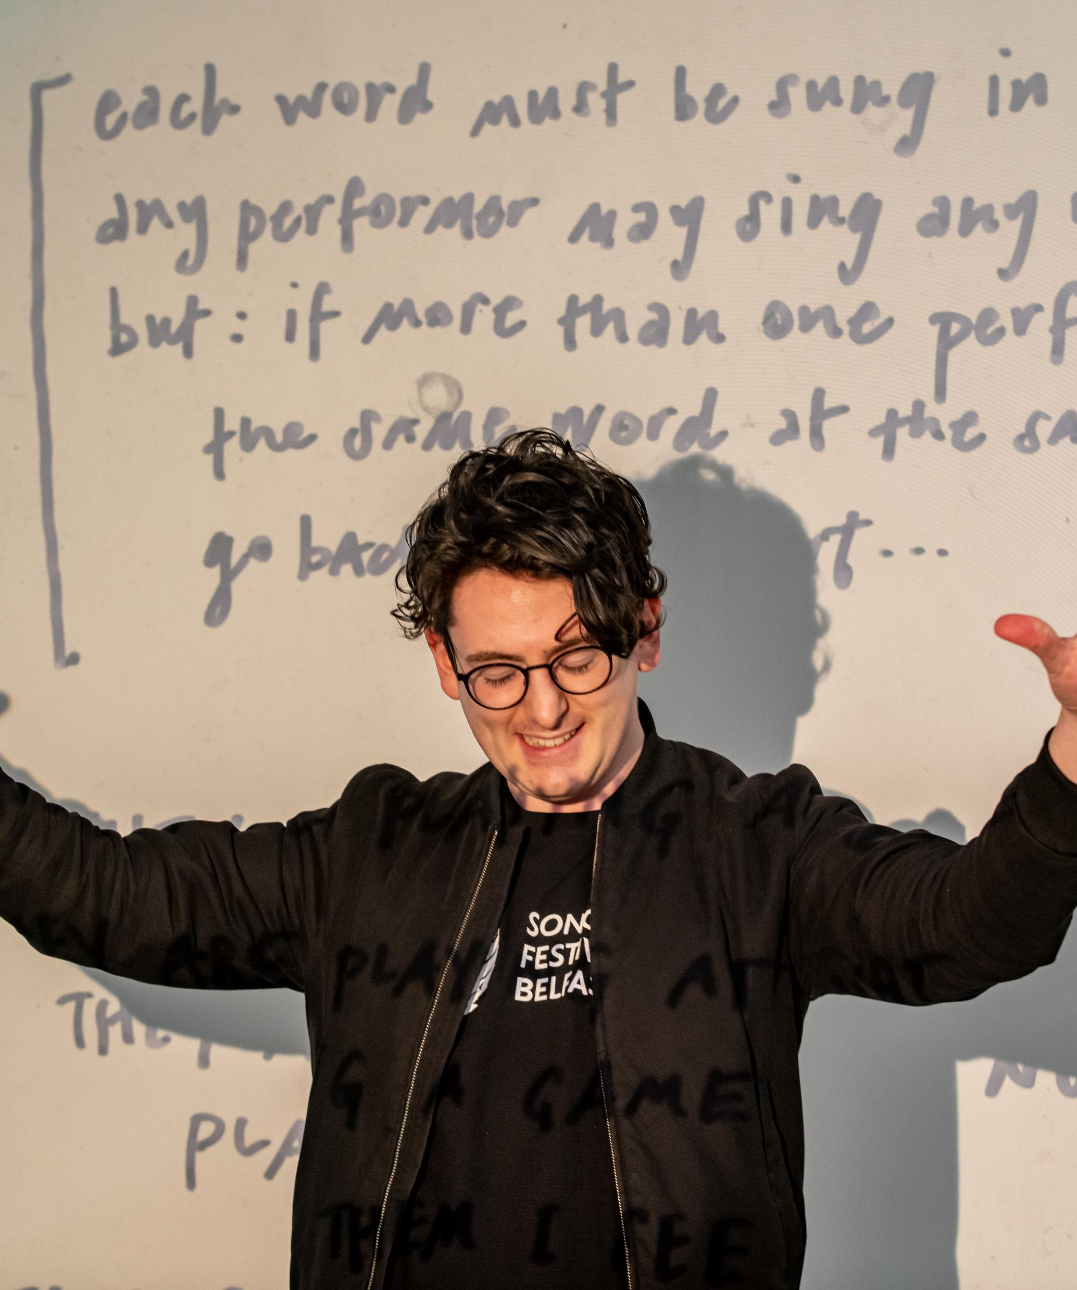
John D’arcy - Digital Media Lecturer at Queen’s University Belfast
Dr John D’Arcy is an artist-researcher based at the Sonic Arts Research Centre at Queen’s University Belfast. John teaches audio production, radio and podcasting, and interactive media. His research involves audiovisual artworks, sound art, and participatory song-making. John directs and composes music for experimental vocal ensemble HIVE Choir, creating site-specific and participatory performances with found texts and melodic improvisation. He co-founded sound art collective Umbrella and curates sound art events and exhibitions at Sonorities Festival Belfast. John is a board member of the Irish Sound Science and Technology Association and was a member of the Steering Group for Belfast’s successful bid for UNESCO City of Music status.

Slide 18
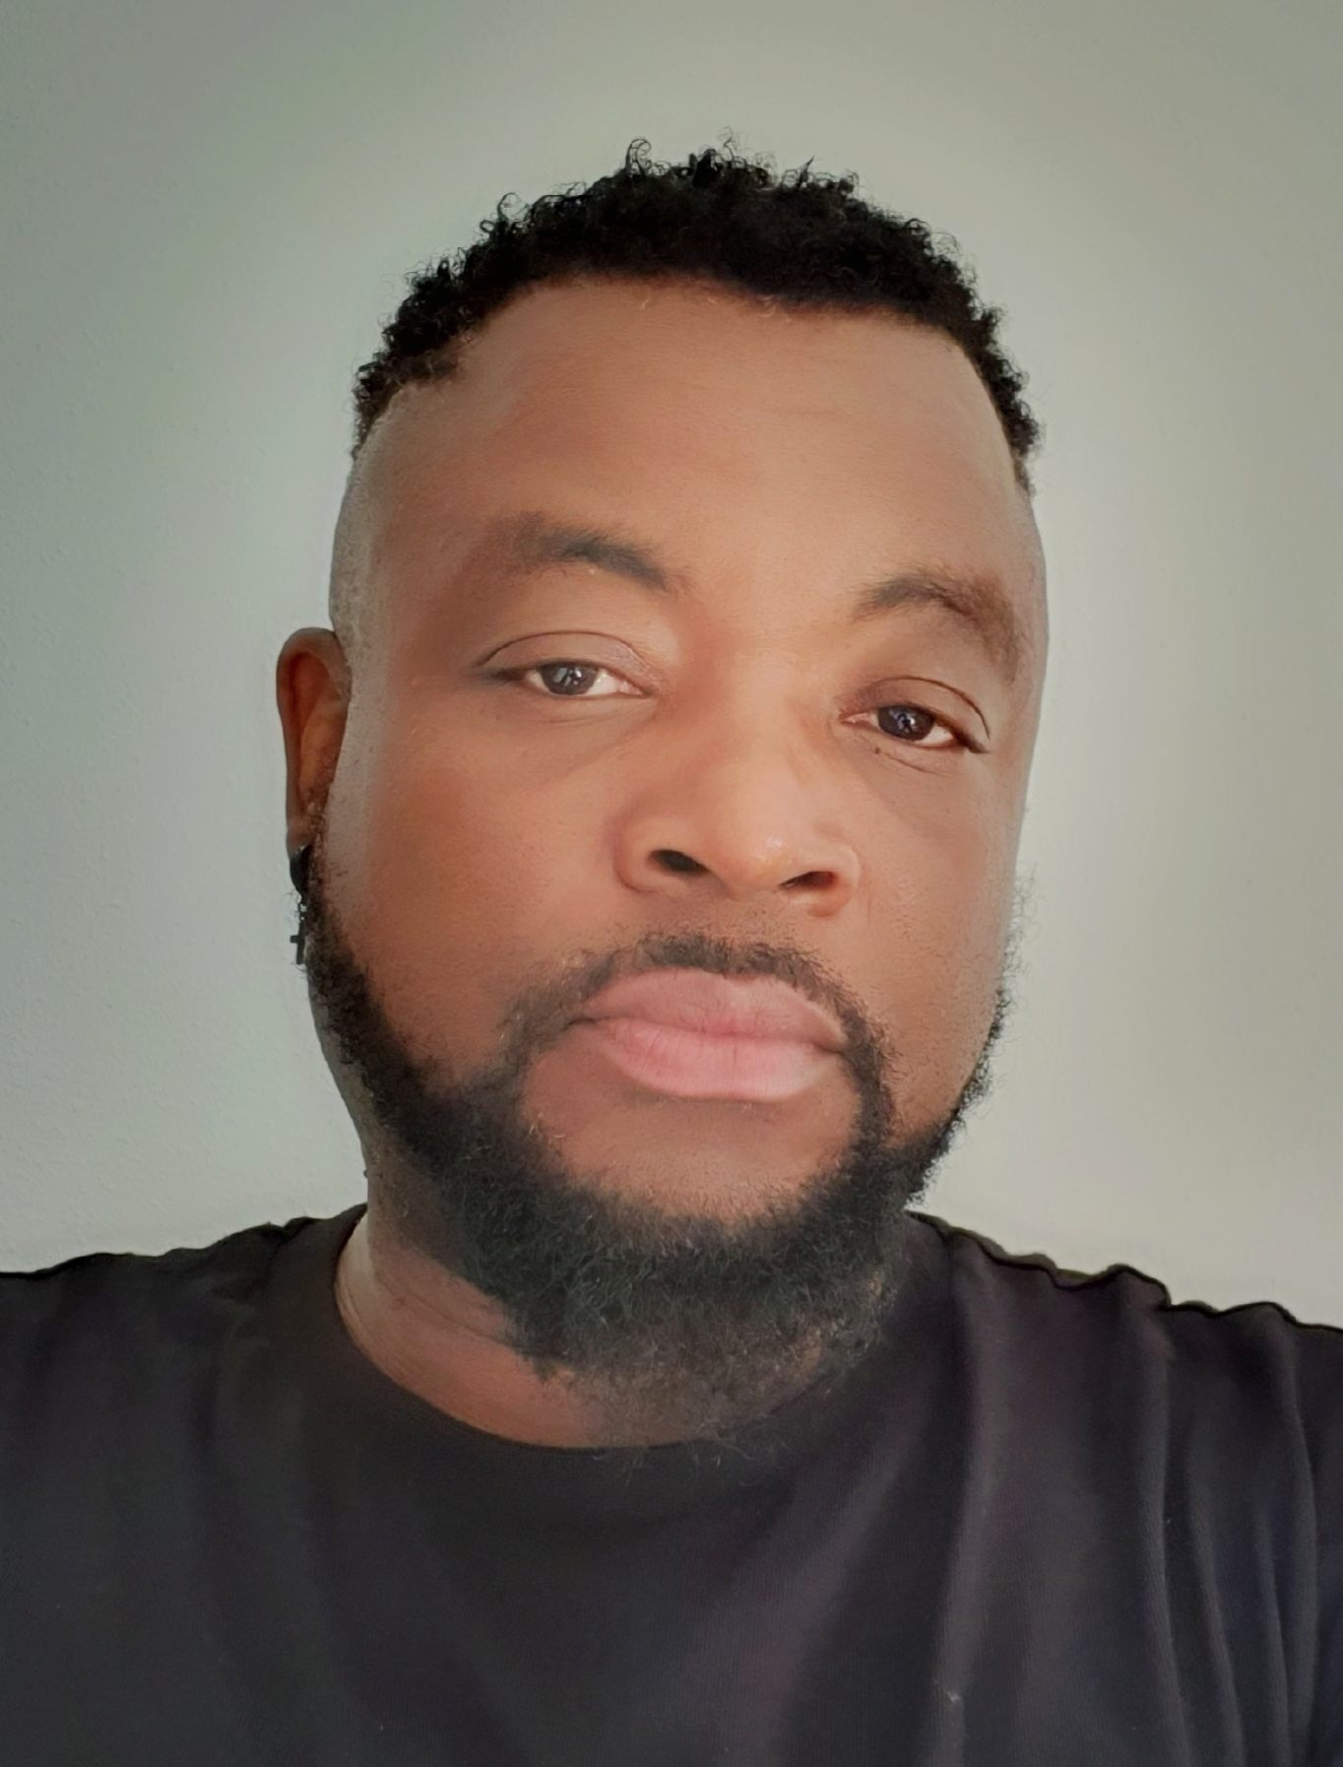
Joseph Ricketts - Artist Manager at Nxgen Music Group
Joseph Ricketts (Jo) is a Jamaican born Artist/Music Manager with over 15+ years of experience across different music industries. He has also worked fulltime in management and as board executive in the community and arts sector for over 10 years.
He is a member of the MOBO voting Academy for 2022/23 and the UK-wide PRS Power-UP programme, levelling-up for under-represented artists, improving visibility, promoting equity, fairness and excellence in music.
Jo is the founder of Nxgen MG, a music management platform specializing in professional music development and management for urban musicians in genres like hip-hop, R&B, reggae dance hall, pop, and anything alternative and game changing.
Jo's growing roster of talented artists is at the heart of his work and reflects the new and evolving music scene locally. He has facilitated major record deals, including a notable signing with Sony RCA London. He collaborated with renowned organisations like the BBC and Netflix, securing sync and brand opportunities for his artists.
Jo also embraces new music technology (AR, AI, Web3, NFTs), and opportunities to learn more.
To remain ahead of the curve in this ever- changing music industry Jo challenges himself and those he works with to keep learning, evolving, pushing creative boundaries and creating unique musical experiences.

Slide 19
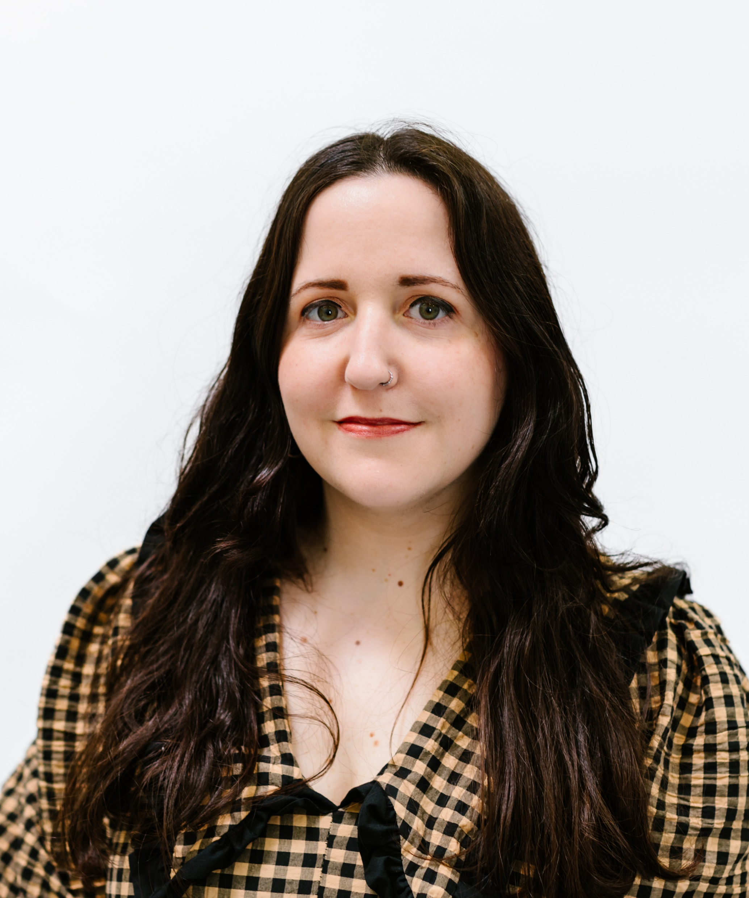
Maurane Ramon - Client and Communications Manager at Thrive
Maurane is the Head of Client Development at thrive. Thrive supports NI arts, culture and heritage organisations and freelancers with audience research, evaluation and communications. She also teaches the audience development module of the M.A. in Arts Management at Queen’s University Belfast.
Previously, she worked at Gilded Artists, Labels and Music in Dublin as a Music PR Assistant for over 2 years. Gilded ALM work with a wide variety of international and Irish indie labels to promote their artists’ releases nationwide. Their roster includes Rough Trade, Sub Pop, Secretly, Partisan, 4AD, WARP and more.
Additionally, Maurane has been a freelance artist liaison/music festival production assistant for the past 8 years and has worked for numerous festivals and promoters in Ireland and Northern Ireland, including Aiken Promotions, All Together Now, Stendhal Festival and the Northern Ireland Music Prize.

Slide 20
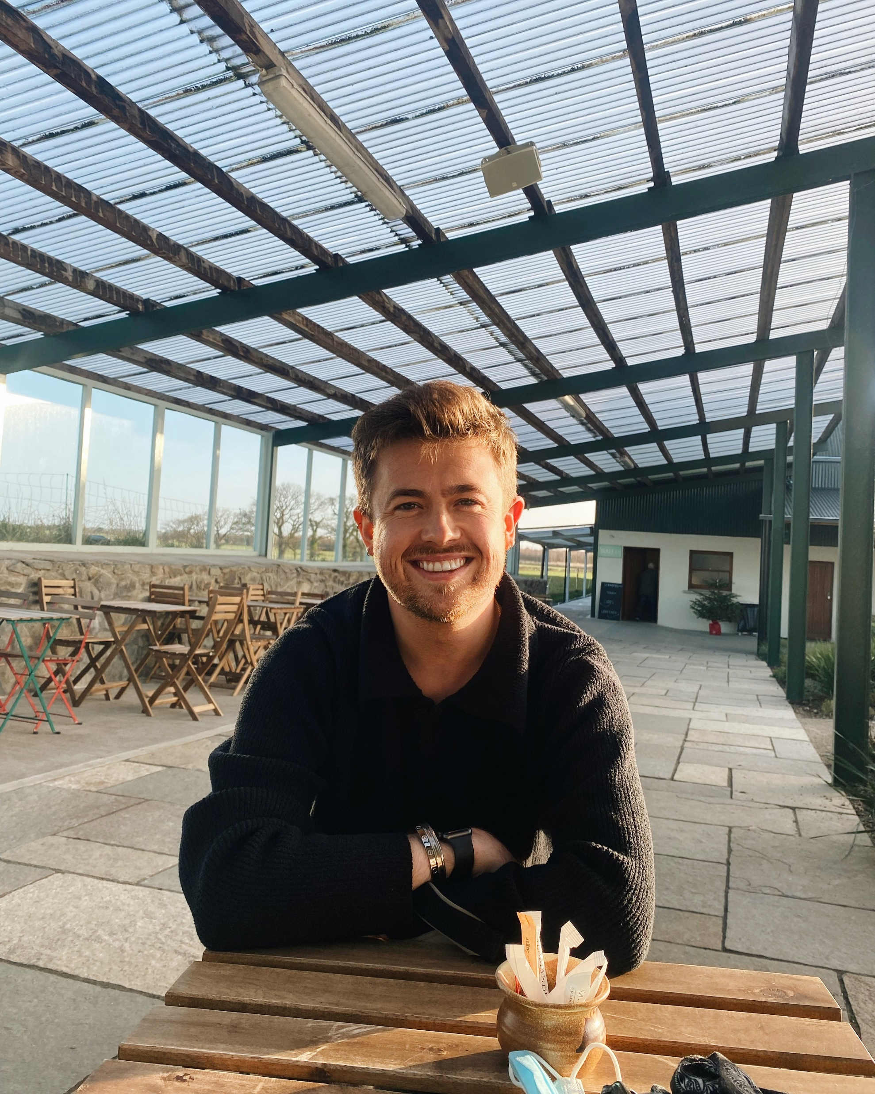
Miceál Mullen - Communications Officer for European Music Council
(1/2)
Hailing from Killean, South Armagh, Miceál Mullen grew up surrounded by a musical family and his insatiable love for music has been nurtured throughout his career path thus far.
Miceál has been performing with the Irish traditional music band CUIG for over seven years and has had the opportunity to perform on multiple tours of the USA and Europe, performing to audiences of up to 80,000 people at some renowned venues including KKL in Luzern, Ireland's Croke Park and at Milwaukee Irish Fest. CUIG have gone on to release two full length studio albums, ‘New Landscapes’ and ‘The Theory of Chaos’ and have their music featured in advertising campaigns including for Aer Lingus, filmed at Milwaukee Irish Fest 2018, the biggest Irish festival in the world, which has clocked over 650,000 views to date and been coined ‘Best New Irish Band’ by the Irish American News.

Slide 21
Miceál Mullen - Communications Officer for European Music Council
(2/2)
In addition to his performing career, Miceál completed a bachelor’s and master’s degree in music and music industries from Dundalk Institute of Technology and The University of Glasgow. From here, Miceál has had the opportunity to collaborate with renowned artists and work with reputable record labels and organisations in Scotland, including the Scottish Music Industry Association with whom he led the InTune Initiative Podcast, which focused on inspiring and promoting inclusivity and representation in the local Glasgow music scene. These experiences provided him with invaluable insights into the inner workings of the music industries, from artist management and promotion to distribution and marketing strategies.
Driven by a desire to contribute to the broader music community, Miceál transitioned into the realm of communications. This has propelled Miceál into his current role as Communications Manager at the European Music Council, regional group for Europe of the International Music Council (IMC), a leading organisation dedicated to promoting and supporting the diverse music cultures in Europe. In this capacity, he plays a crucial role in membership development, fostering collaboration among stakeholders, and raising awareness about the importance of music in society in Europe and beyond.

Slide 22
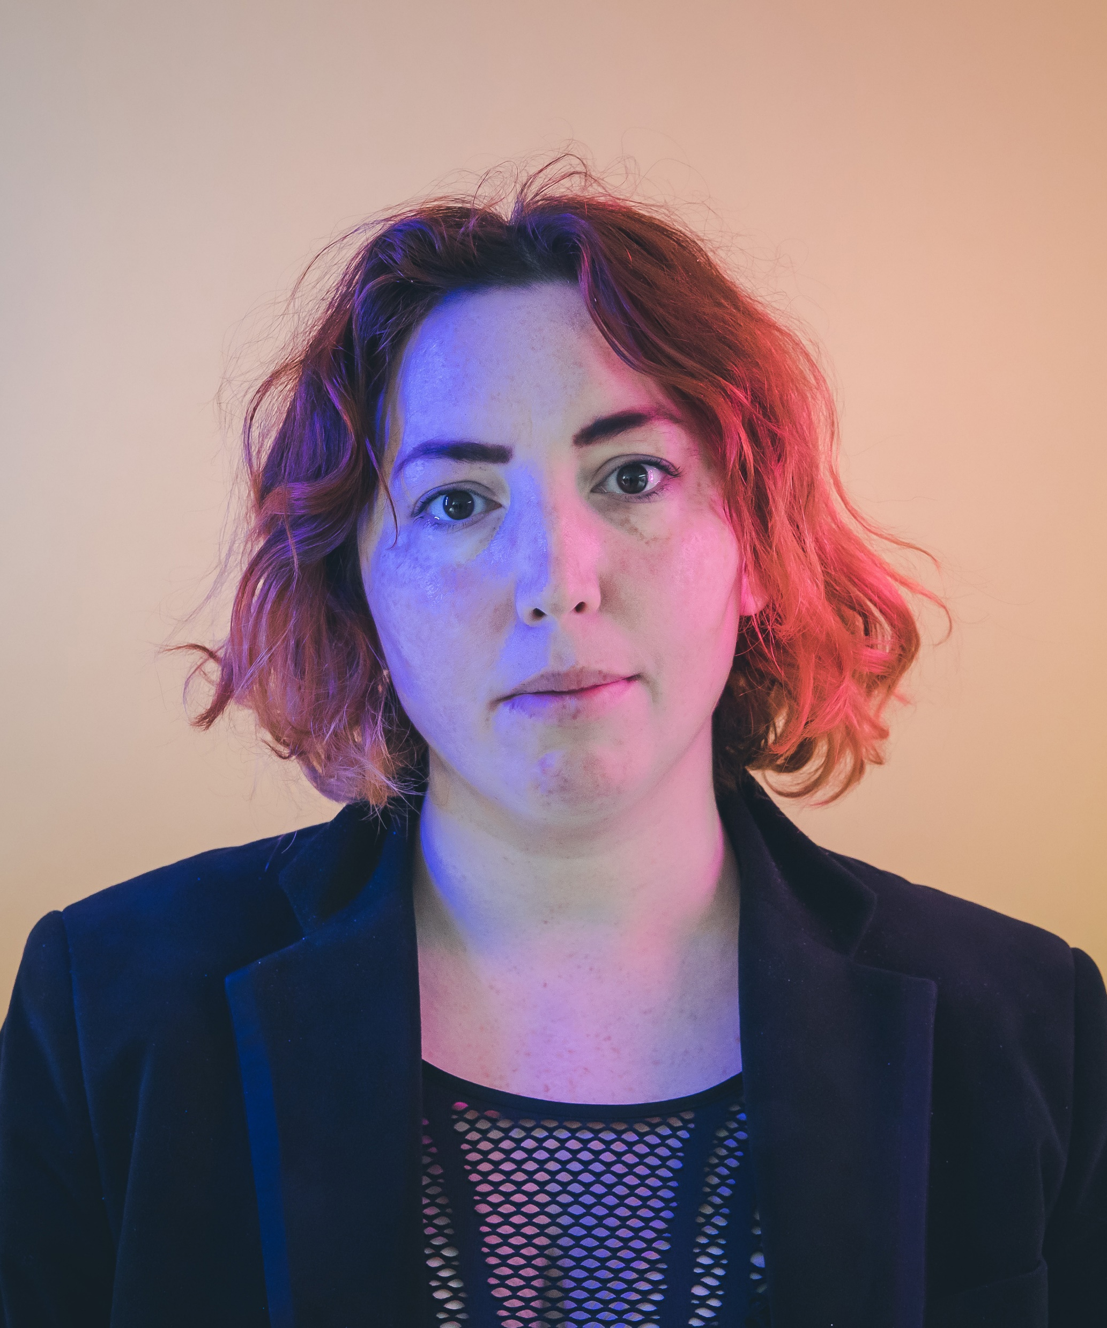
Naoise Roo Callan - Festival Development and Coordinator for NI Mental Health Arts Festival
Naoise Roo Callan is a solo musician and music professional from Dublin, Ireland. Naoise has released one full length album (Lilith, 2015) and a four track EP (Sick Girlfriend, 2020) focused on mental health and the stereotyping of women with mental health issues. The Sick Girlfriend EP project was supported by a Dublin City Council Project Grant and led to her being signed to American label Schoolkids Records at the end of 2020.
In addition to her musical career, Naoise is a highly experienced festival production manager and booker for independent stages at Electric Picnic and Latitude. She is the recipient of several notable grants that have helped further her songwriting and musical work, she was also chosen as a Keychange Innovator Participant for 2022 for her work in the industry. She is also a regular contributor and volunteer with Girls Rock Dublin. As a recipient of the MISP Recording Stimulus Fund grant in 2020, she is due to release her next full length record this Autumn 2023. More recently she has participated as a panellist for the creative careers summit and worked in festival development.

Slide 23
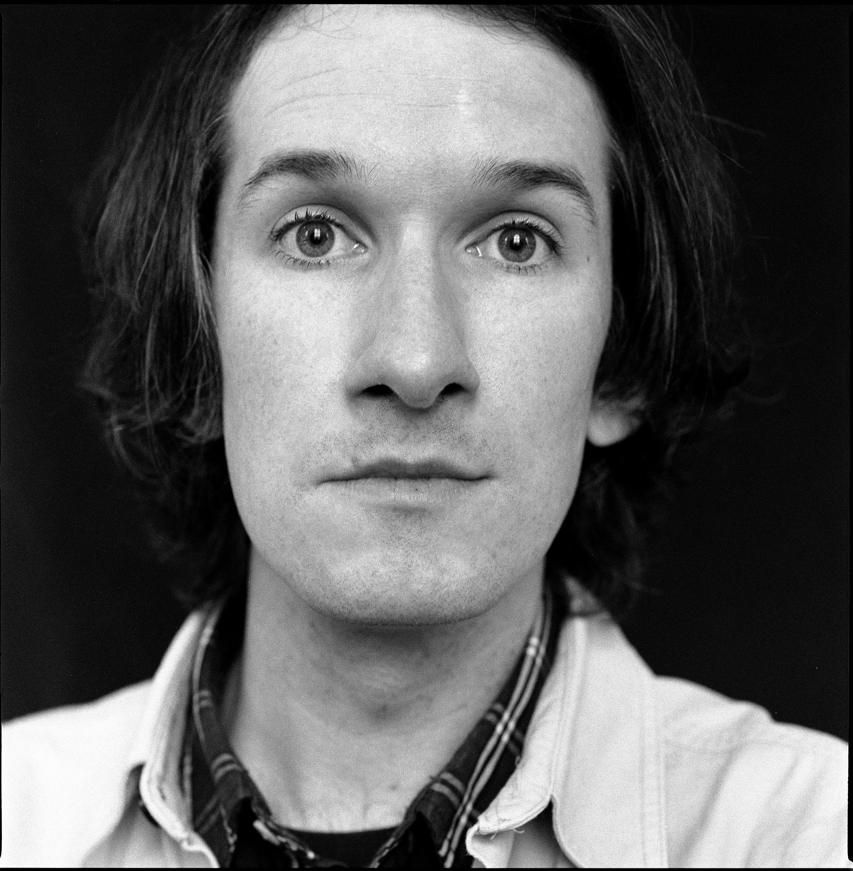
Paul Connolly - Musician / Workshop Facilitator / Lecturer
Paul Connolly is the singer, guitarist and songwriter with NI Music Prize winning band, The Wood Burning Savages. He has toured the U.K. and Europe, playing countless festivals; most notably two Glastonburys and SXSW in Texas. TWBS have also represented NI in various music delegations in countries such as Poland, Georgia and Armenia.
Paul is also deeply involved in creative industries education based in the community, working on behalf of the Nerve Centre across NI delivering music and performance workshops to young people. Paul is also chief lecturer for the Nerve Centre’s FT Event Management & Communications courses. This work involves working closely with organisations such as Education Authority, Prince’s Trust and OCNNI.
Paul is also involved in the Oh Yeah Music Centre’s Elevate after school programme, providing a space for young people from all over Belfast to develop their skills and write music alongside their peers.
Paul’s background in product design and obsession with guitars and effects units has also seen him work closely with and be endorsed by music equipment manufacturers such as Rosetti Ltd, Revelation Guitars, Cleartone Strings and Reverend Guitars.
When not doing any of the above he can be found writing for Belfast based Dig With It, a magazine celebrating the vibrant arts and music community of Northern Ireland. He can also be found as a regular panellist and contributor on BBC Radio Ulster and Radio Foyle.

Slide 24
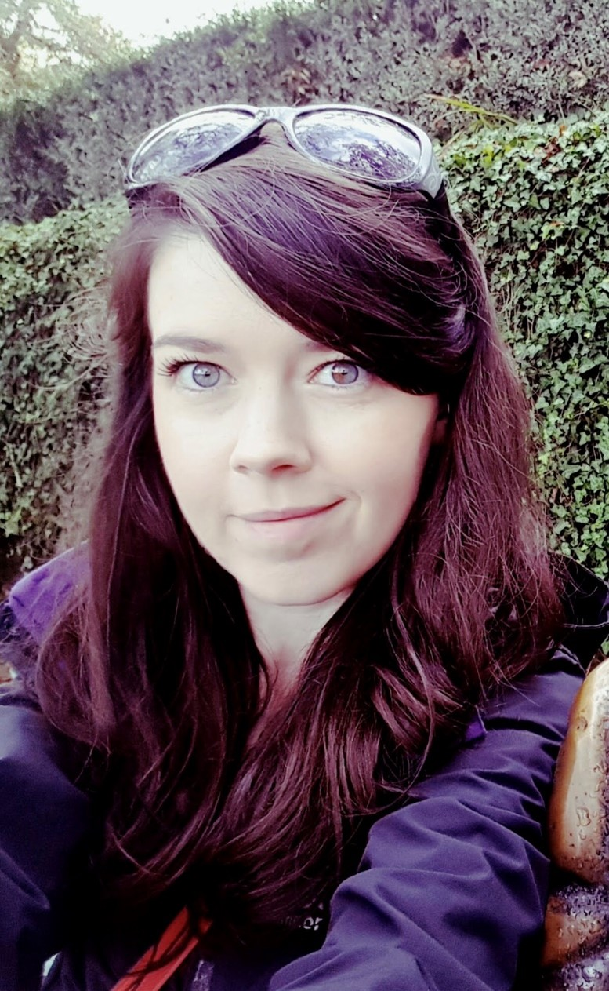
Paula McColl - Creative Producer at Moving on Music
My background in music is as an Irish Traditional Fiddle player (for 20+years). I have taught music privately and at Comhaltas groups and music schools across NI and performed (at an amateur level!) for a number of years, however I now mainly play socially at sessions, fleadhs, etc.
I studied a degree in Music at Ulster University Magee and then went onto complete a MSc in Cultural Management at the UU Belfast Campus. I began working with MOM as a volunteer while completing my masters degree as I found the diversity of their work really interesting. I was subsequently hired on a freelance basis in 2014 and then as an employee in 2015 to oversee their Touring and Outreach programme. In 2020 as Brian Carson stepped away from the company, I took on the Creative Producer role alongside Michael Bonner, and we now both oversee the management of the organisation. My role involves running the music touring programme, management, financial, fundraising and strategic responsibilities, programming and logistics for our year round concert programme, so like all jobs in the arts it is an incredibly rewarding and varied role that I consider myself privileged to have.

Slide 25
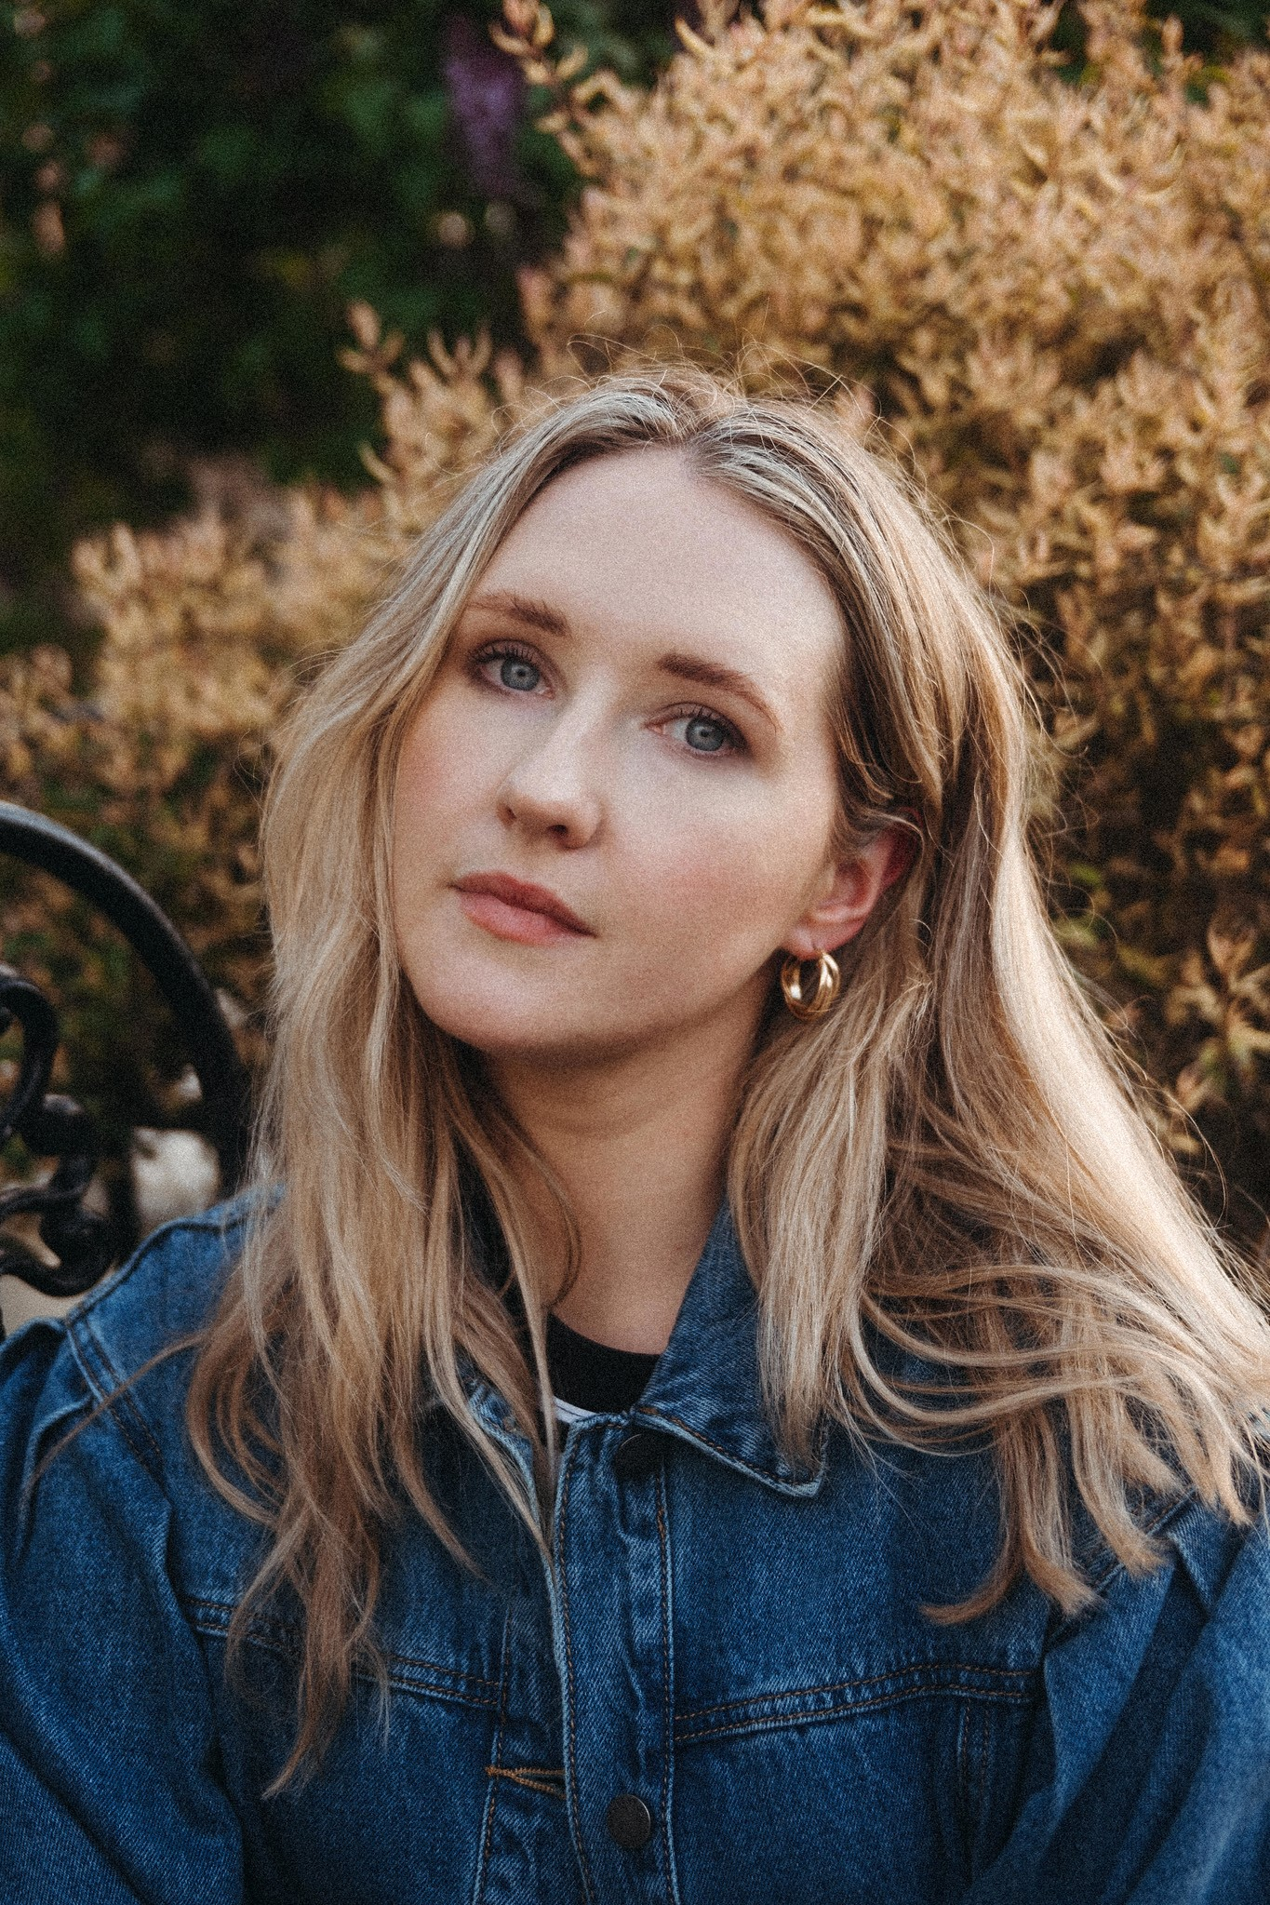
Rebekah Lutton - Singer-Songwriter
Rebekah Lutton is a Belfast Based singer songwriter known for her work under the pseudonym Lilla Vargen. She has toured with acts including Dermot Kennedy, James Bay and Lisa Hannigan. Lilla has accumulated over 70 million streams across platforms and she is currently working on a new EP due for release in 2024.

Slide 26
Ron Stitt – Bb Flute Tutor and Member of Marching band
Ron has been involved in the Arts and Cultural environment through a voluntary capacity from childhood and was an active member of the Ulster Bands Association - a lobby group for marching bands across different sectors.
Having been a member of a marching band for over 40 years, Ron has witnessed first-hand the social side as well as the musical achievements within the local marching band culture which are key to further improvement and development.
In that regard, Ron has been involved in collaborations over many years with the Arts and Local Music sectors which in turn has widened the audience for the marching band genre.
This has included performances for both Theatre Plays and TV appearances, including such as an appearance on Sky Atlantic series ‘The Lovers’ based around Belfast and London.
As a member of a marching band, Ron took part in the project “Fifes and Fusion” arranged through EastSide Arts with the aim of making different genres accessible to a wider audience. This was a collaboration of local music artists which integrated the marching band repertoire with folk music and song. The output of this project included performances at the Mac Theatre and CS Lewis Square.
Ron has dedicated his time to teaching Bb Flute to all age groups of various levels, including those with ADHD/hidden disabilities, and finds this very rewarding.

Slide 27
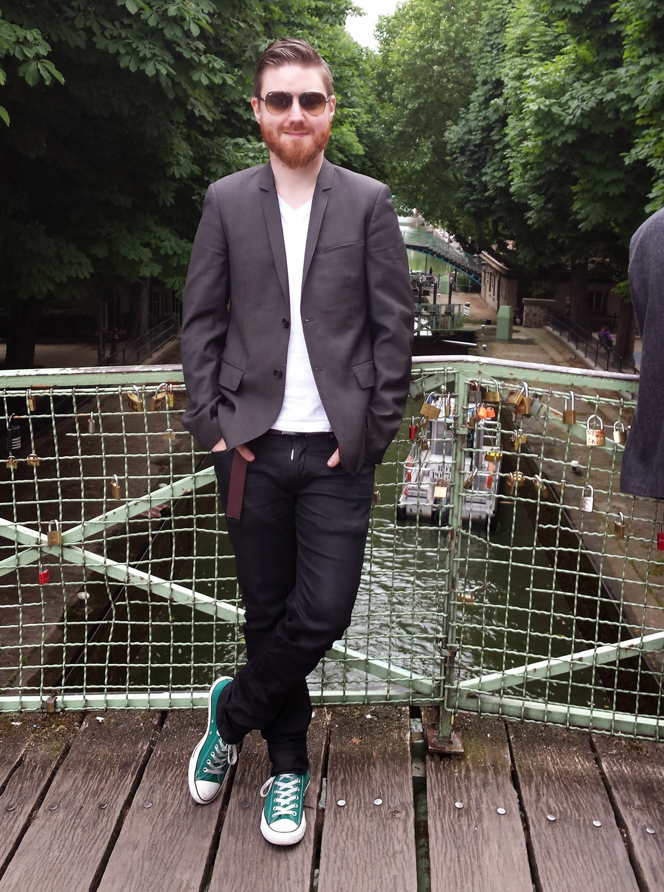
Rory McConnell - Editor, Music Arts and Events at BBC Northern Ireland
(1/2)
When one thinks of the grass-roots music scene in Northern Ireland over the past two decades, a scene that has produced the likes of Two Door Cinema Club, And So I Watch You From Afar, and Soak, it’s impossible to consider it without the work of Rory McConnell.
Immersed in the local music world from a young age, he joined the team of BBC Radio Ulster’s award winning Across the Line show at the age of 16, a programme he would later present and produce. Breaking new bands locally every week on the airwaves, he’d make the leap from regional broadcasting to network radio, becoming the host of BBC Introducing in Northern Ireland on BBC Radio 1. Every week, the entire UK could get a taste of an eruption of young musical talent, curated and developed by Rory McConnell. Offering live session experience to new bands, helping make connections within the national music industry, and offering advice and mentorship, he was a lynchpin at a time when Northern Ireland was arguably the most musically fertile part of the UK.

Slide 28
Rory McConnell - Editor, Music Arts and Events at BBC Northern Ireland
(2/2)
Outside the confines of the studio, he staged live concerts featuring some of the hottest acts in the country, taking over venues across Northern Ireland, to record new bands in their natural environment. This would lead to a partnership with Paddy Glasgow and his Glasgowbury music festival, with Rory McConnell’s BBC Radio 1 show curating the main stage, recording the acts, and bringing the majesty of the Sperrin mountains to a national audience. He also curated a special concert in Belfast’s Mandela Hall which brought the four nations of the UK together in a spectacular event, headlined by Two Door Cinema Club, just ahead of the release of their critically acclaimed debut album. And through these connections, over the years, many Northern Irish artists would perform at some of the UK’s biggest festivals, including Glastonbury and Reading / Leeds, selected and supported by Rory McConnell.
In addition to his work as a broadcaster and producer, Rory also ran the Di Di Mau record label, releasing debut albums by some of the most revered local acts, including A Plastic Rose and Dutch Shultz. Heading up a team including Jon Ollier, best known for his work with Ed Sheeran, the label achieved worldwide distribution, helping local acts turn music from a hobby into a career. And on the live scene, his promotions company attracted top level talent to venues in Belfast and Derry.
Rory is still immersed in the world of broadcasting and music, currently in the role of overseeing Music, Arts, and Events for BBC Radio Ulster, continuing to innovate, bringing radio visualisation to the station for the first time, as well as his tireless support and development of artists, maintaining Northern Ireland’s reputation as a musical trailblazer. As long as there is a Northern Irish music scene, you’ll find Rory McConnell at the heart of it.

Slide 29
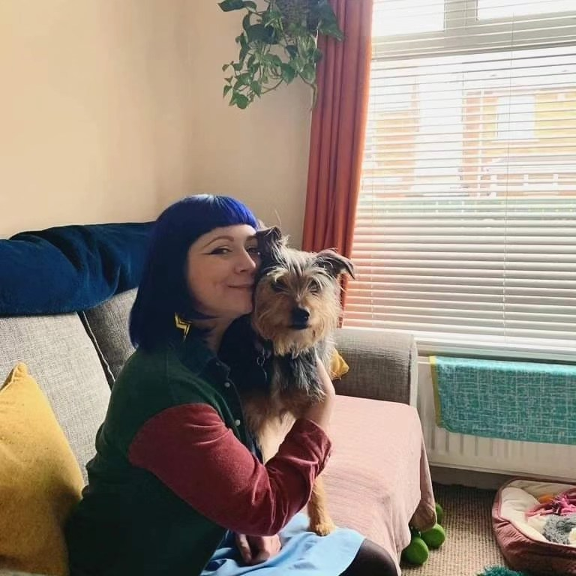
Nikki MacRae – Music Lead & UNESCO Focal Point, Co-Founder Soft Gut Song Camp
I began my career in the music industry through promoting gigs under the pseudonym ‘Hidden Machine’ alongside co-presenting / producing Irish music specialist show ‘Through The Wall’ on Blast106. Following this I supported the launch of the first regional office of independent music charity Help Musicians in 2016 as the first full-time member of staff outside of England.
I spent the next six years supporting artists to thrive in their careers primarily through this charity. I counted highlights such as delivering the Women in Music Fund to develop major works by local organisations to benefit female-identifying and non-binary individuals in their careers and personal confidence, as well as curating a monthly informational public ‘expert series’ as part of the Three Bands in Three Years programme.
Outside of this, I worked as an artist manager and in 2021 I was proud to receive the AIM ‘local hero’ award alongside receiving an fDip in Music Business with Distinction from BIMM Dublin. In 2021 I co-founded the Soft Gut Song Camp - an initiative designed to unlock the collaborative potential of artists, songwriters and producers across Ireland.
As of 2022 I am the dedicated music officer for Belfast City Council and I have the joy of working on the implementation of the Council's music strategy. I am the Focal Point for Belfast within the UNESCO City of Music network.

